Slide 1
Table of content
Introduction
Literature Survey
Components Required
Block Diagram of Working Module.
Description of Components
Conclusion
Future Scope
References

Slide 2
Introduction
Our project focuses on enhancing the effectiveness of electric vehicle battery management systems with charge monitor and fire protection using IOT
Two key innovations:
Charge Monitoring
Fire protection
Charge Monitoring provides us specified data of battery parameters such as current, voltage, temperature and it is not only provided over a monitor using coding and IoT we can also monitor these parameters over our mobile phones.
If there would be any disturbance in the desired parameter the auto-cut mode will be implied and the charging will stop immediately.
Fire protection is a safety measure used to overcome the drawback of Li-ion battery for over heating, due to the instructions fed to the Arduino UNO it provides a safety to the device as well as to the owner.
For example: If there is a case of over charging which is also a hazard to battery life due to smart charging the battery will be disconnected automatically from the charging mode.
Similarly in case of over heating Fire protection mode will be on and it will provide different parameters to cool down the battery and saves the battery life of device.

Slide 3
Literature survey
Zhou Li. et al. in “ RESEARCH ON FIRE PROTECTION TEST TECHNOLOGY OF ELECTRIC VEHICLE POWER BATTERY SYSTEM ” has discussed that the thermal runaway process in EVs go through the heat storage stage and developed a model which monitor all the parameters for protecting the device.
Vekhande A. et al. in “ IOT-BASED BATTERY PARAMETER MONITORING SYSTEM FOR ELECTRIC VEHICLE ” described that a system is developed with a real time scenario for the indication of the battery’s voltage , current and the remaining charge capacity can be calculated by using IoT and it also monitors the performance of the vehicle.
Kumar V. K. et al. in “ BATTERY MONITORING SYSTEM IN ELECTRIC VEHICLES BASED ON INTERNET OF THINGS ” has proposed a Battery management system using advanced technology , central processor , interfacing devices and Node – Red environments on the hardware platform. It is a real-time BMS using the coulomb counting methods for estimating State of Charge (SOC) and MQTT as a communication protocol based on messaging.
Sowmya G. et al. in “ EV BMS WITH CHARGE M ONITOR AND FIRE PROTECTION ” has discussed that BMS is one of the most essential part of any Electric Vehicle , not only to monitor the performance but also to protect the battery this model functions current , voltage measurements , state of charge (SOC) calculation , battery status calculation ,liquid crystal display (LCD),etc.
Hariprasad A. et al. in “ BATTERY MANAGEMENT SYSTEM IN ELECTRIC VEHICLES ” has discussed about different states of battery charging as state of charge , state of health , state of life , etc and also discussed about the maximum capacity of a battery. In this model they used different techniques to monitor voltage , current and ambient temperature to reduce the possibility of the damage.

Slide 4
Components required
1.Transformer (12V, Step Down)
2. Voltage Regulator (5V)
3. Arduino UNO
4. Temperature Sensor
5. Voltage Sensor
6. Current Sensor
7. Relay
8. Buzzer
9. Li-ion Battery Cell
10. Brushless DC Motor
11. Fan (12V DC)
12. ESP8266 Wi-Fi Module
13. LCD Display

Slide 5
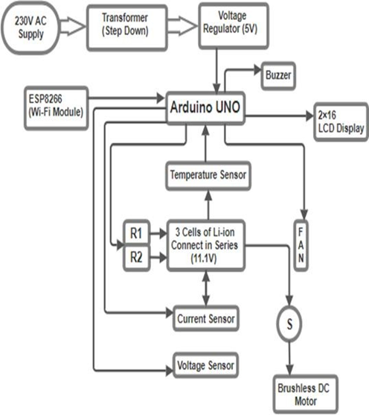
Block diagram of proposed Model

Slide 6
Description of components
This proposed system consist of Arduino microcontroller that connects to an Android app through a Wi-Fi module.
An 230V 50Hz AC supply is needed to start the process.
A 12-0-12 , 1.5 Amp Transformer is used to step down the voltage which is fed to voltage regulator.
7805 Voltage regulator is used to regulate the voltage up to 5 V which is given to Relays and Arduino UNO.
5V relays are used to switch on or off the charging of Li-Ion Battery.
The Li-ion battery is balanced charged using a 3 cell li-ion battery charging circuit.
The battery temperature is measured using a LM35 temperature sensor that is attached to an Arduino's analog pin and indicates high temperature when it crosses 45° C.
A fan which is connected to the Arduino is automatically turned on to reduce the battery temperature.
The battery voltage is measured using a voltage sensor, and the results are shown on the app as well as on the LED screen.
Current is also monitored by current sensor and displayed.
A 5v relay linked to the Arduino Uno is turned off when an over temperature is detected, cutting off power to the battery and BLDC motor stops rotating.
This all can also be done by Android phone using IP address of the Wi-Fi Module ESP2866.

Slide 7
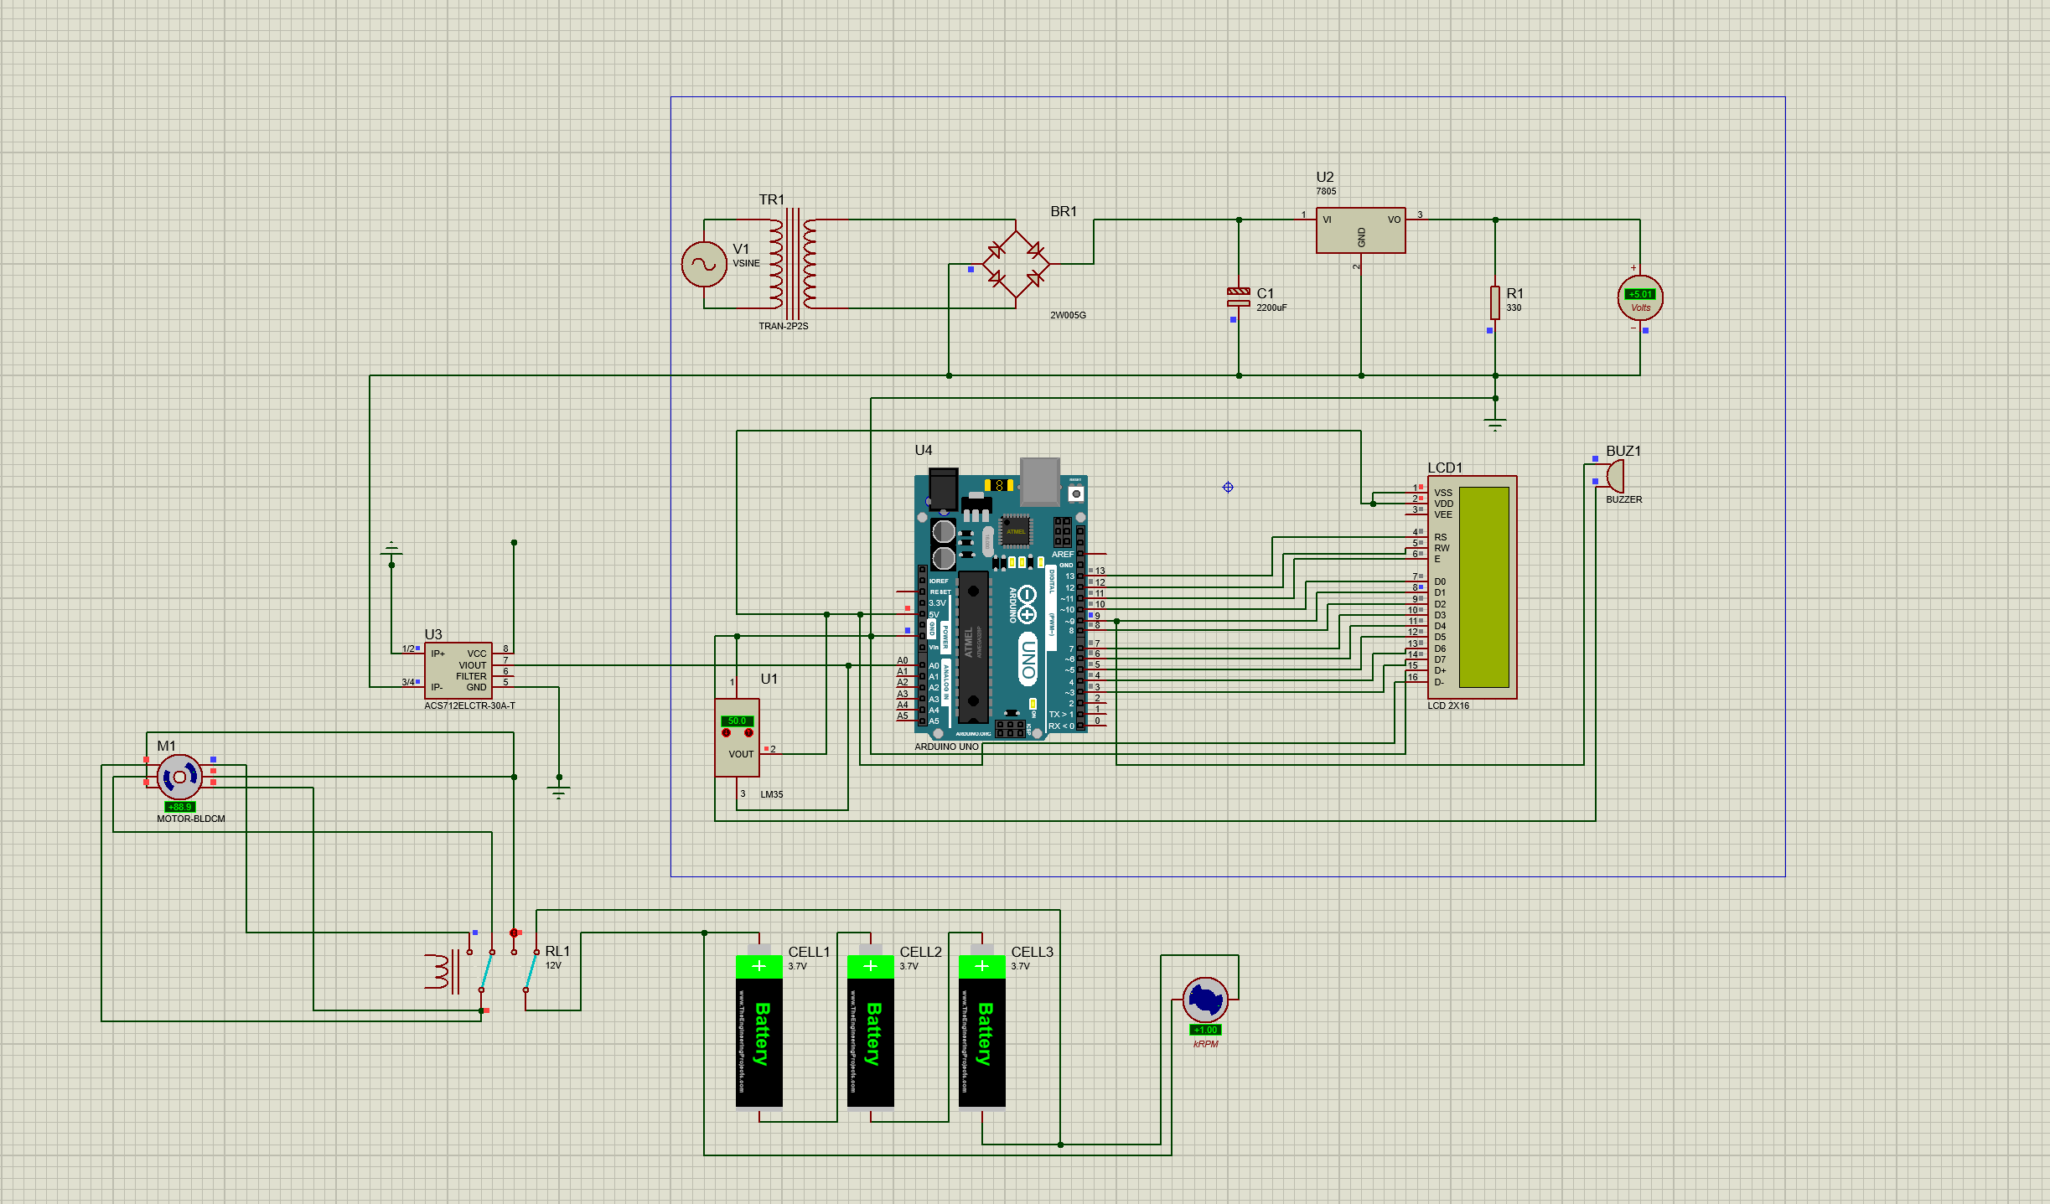
Layout of the simulation

Slide 8
Review Paper Presented in 3rd international conference GLA
presented our review paper in 3rd International Conference Gla, Mathura On 22nd Feb,2024
Currently working over the simulation process as well as the working model.
Soon we will generate a research paper over the results which will be applicable after results provided by the simulation.
There is some technical Issue regarding the simulation on which we are working and soon the results will be seen.

Slide 9
Conclusion
Conclusively, an effective and efficient protection model for Electric Vehicles can be made to avoid unnecessary and hazardous accidents. Some of the key outcomes are mentioned bellow :-
An operating temperature can be maintained for suitable working of Lithium – ion batteries.
Battery can be saved from short circuits by receiving an alarm on android smartphone.
A complete remote monitoring system helps to save man power and also time saving.
It can increase battery life because due to high temperature electrolyte gassing reaction occurs.

Slide 10
Future scope
These future scopes represent ongoing efforts to enhance electric vehicle technology, infrastructure, and sustainability, ensuring that electric vehicles remain a viable and eco-friendly transportation option as they become more prevalent in the automotive industry.
Battery Recycling.
Environmental Sustainability
Battery Energy Density: Fast Charging Infrastructure
Grid Integration

Slide 11
REFERENCES
[1]. Zhou Li and Liao Chenglong. Research on fire performance test technol-ogy of electric vehicle power battery system. In 2022 2nd InternationalSignal Processing, Communications and Engineering Management Con-ference (ISPCEM), pages 340–344. IEEE, 2022
[2]. Jiang Linru, Zhang Yuanxing, Li Taoyong, Diao Xiaohong, and Zhang Jing. Analysis on charging safety and optimization of electric vehicles. In 2020 IEEE 6th International Conference on Computer and Communications (ICCC), pages 2382–2385. IEEE, 2020.
[3]. S Castano, D Serrano-Jimenez, and J Sanz. BMS influence on li-ion packs characterization and modeling. In 2016 IEEE 16th International Conference on Environment and Electrical Engineering (EEEIC), pages 1–6. IEEE, 2016.
[4]. Carlos Vidal, Pawel Malysz, Phillip Kollmeyer, and Ali Emadi. Machine learning applied to electrified vehicle battery state of charge and state of health estimation: State-of-the-art. IEEE Access, 8:52796–52814, 2020.
[5]. Pankhuri Kaushik and Manjeet Singh. Analysis and evaluation characteristics for li-ion battery with impacts of ambient temperature on pure electric vehicle. In 2023 International Conference on Future Energy Solutions (FES), pages 1–6. IEEE, 2023.
[6]. Amit Adhikaree , Taesic Kim, Jitendra Vagdoda, Ason Ochoa, Patrick J Hernandez, and Young Lee. Cloud-based battery condition monitoring platform for large-scale lithium- ion battery energy storage systems using internet-of-things (IoT). In 2017 IEEE Energy Conversion Congress and Exposition (ECCE), pages 1004–1009. IEEE, 2017.
[7]. Gelareh Javid, Michel Basset, and Djaffar Ould Abdeslam. Adaptive online gated recurrent unit for lithium- ion battery soc estimation. In IECON 2020 The
46th Annual Conference of the IEEE Industrial Electronics Society, pages 3583–3587. IEEE, 2020

Slide 12
Thank you

